Slide 1



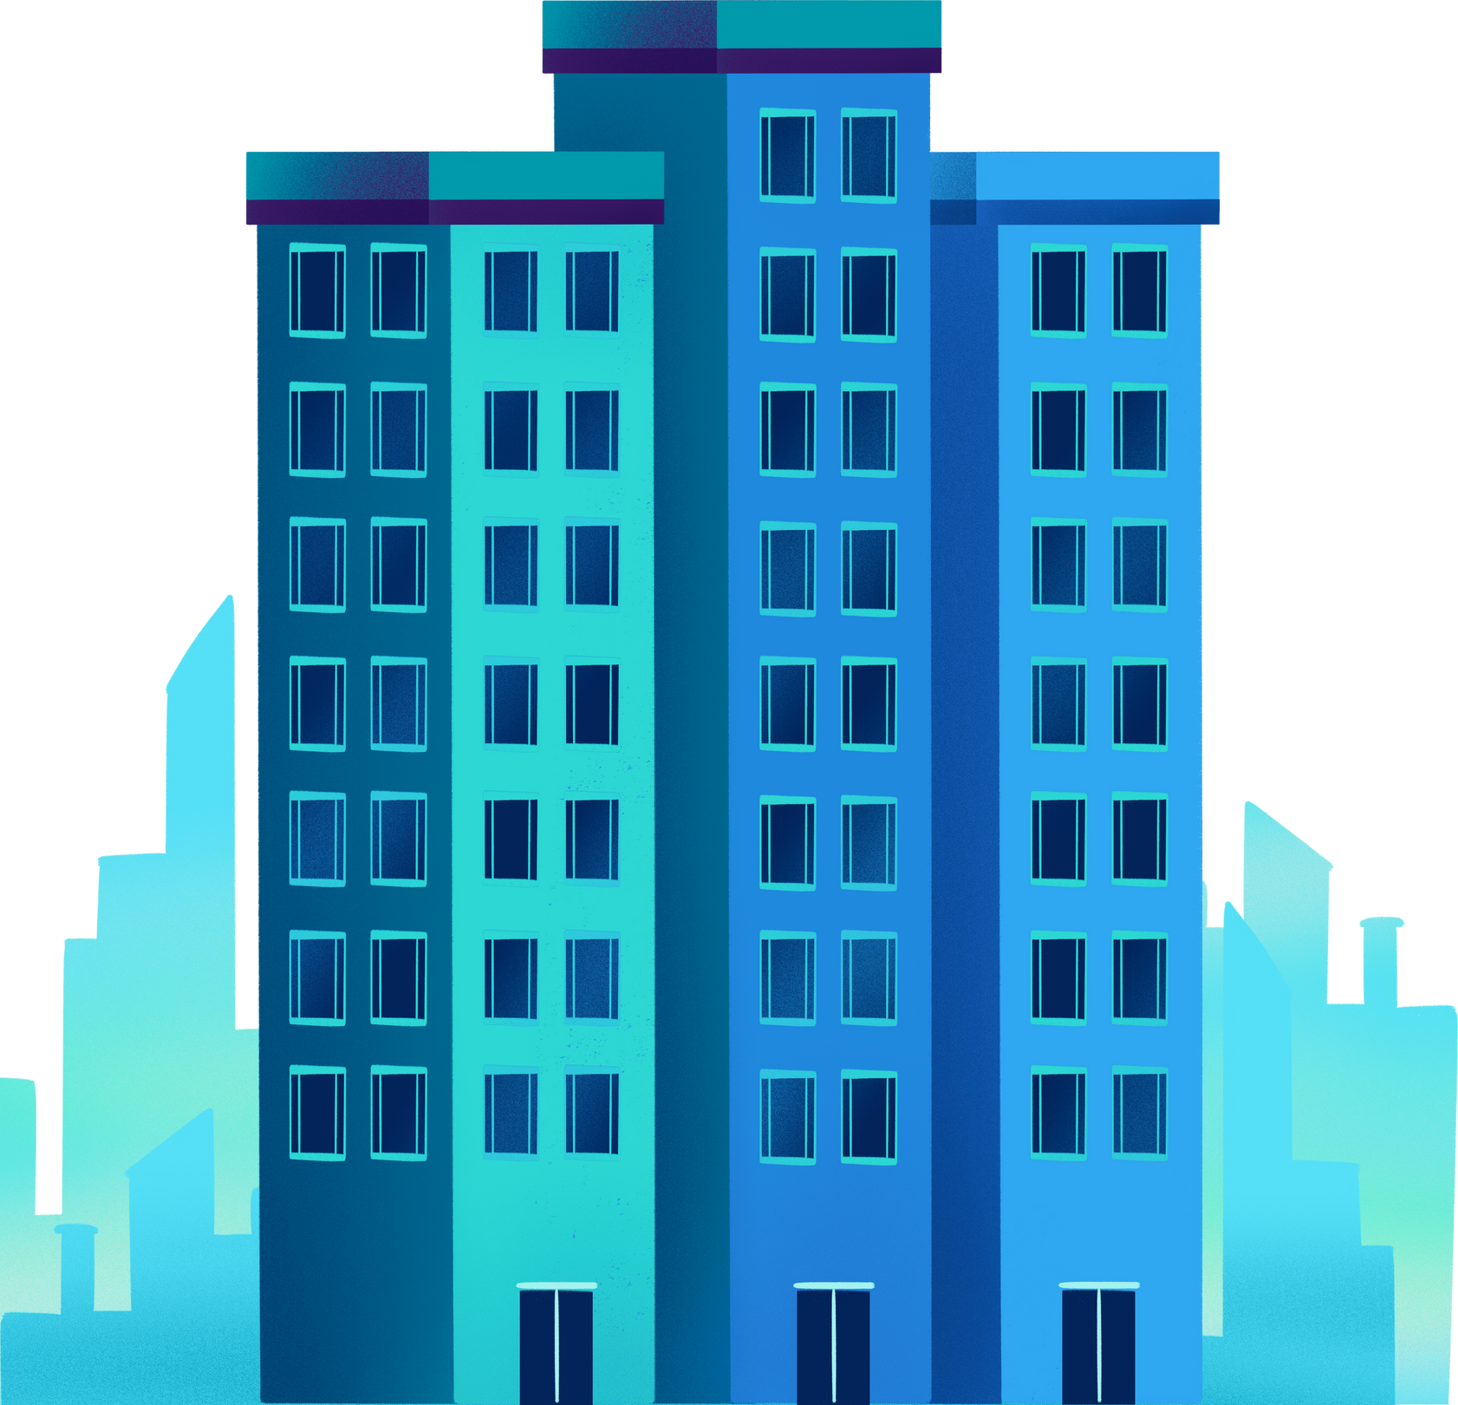

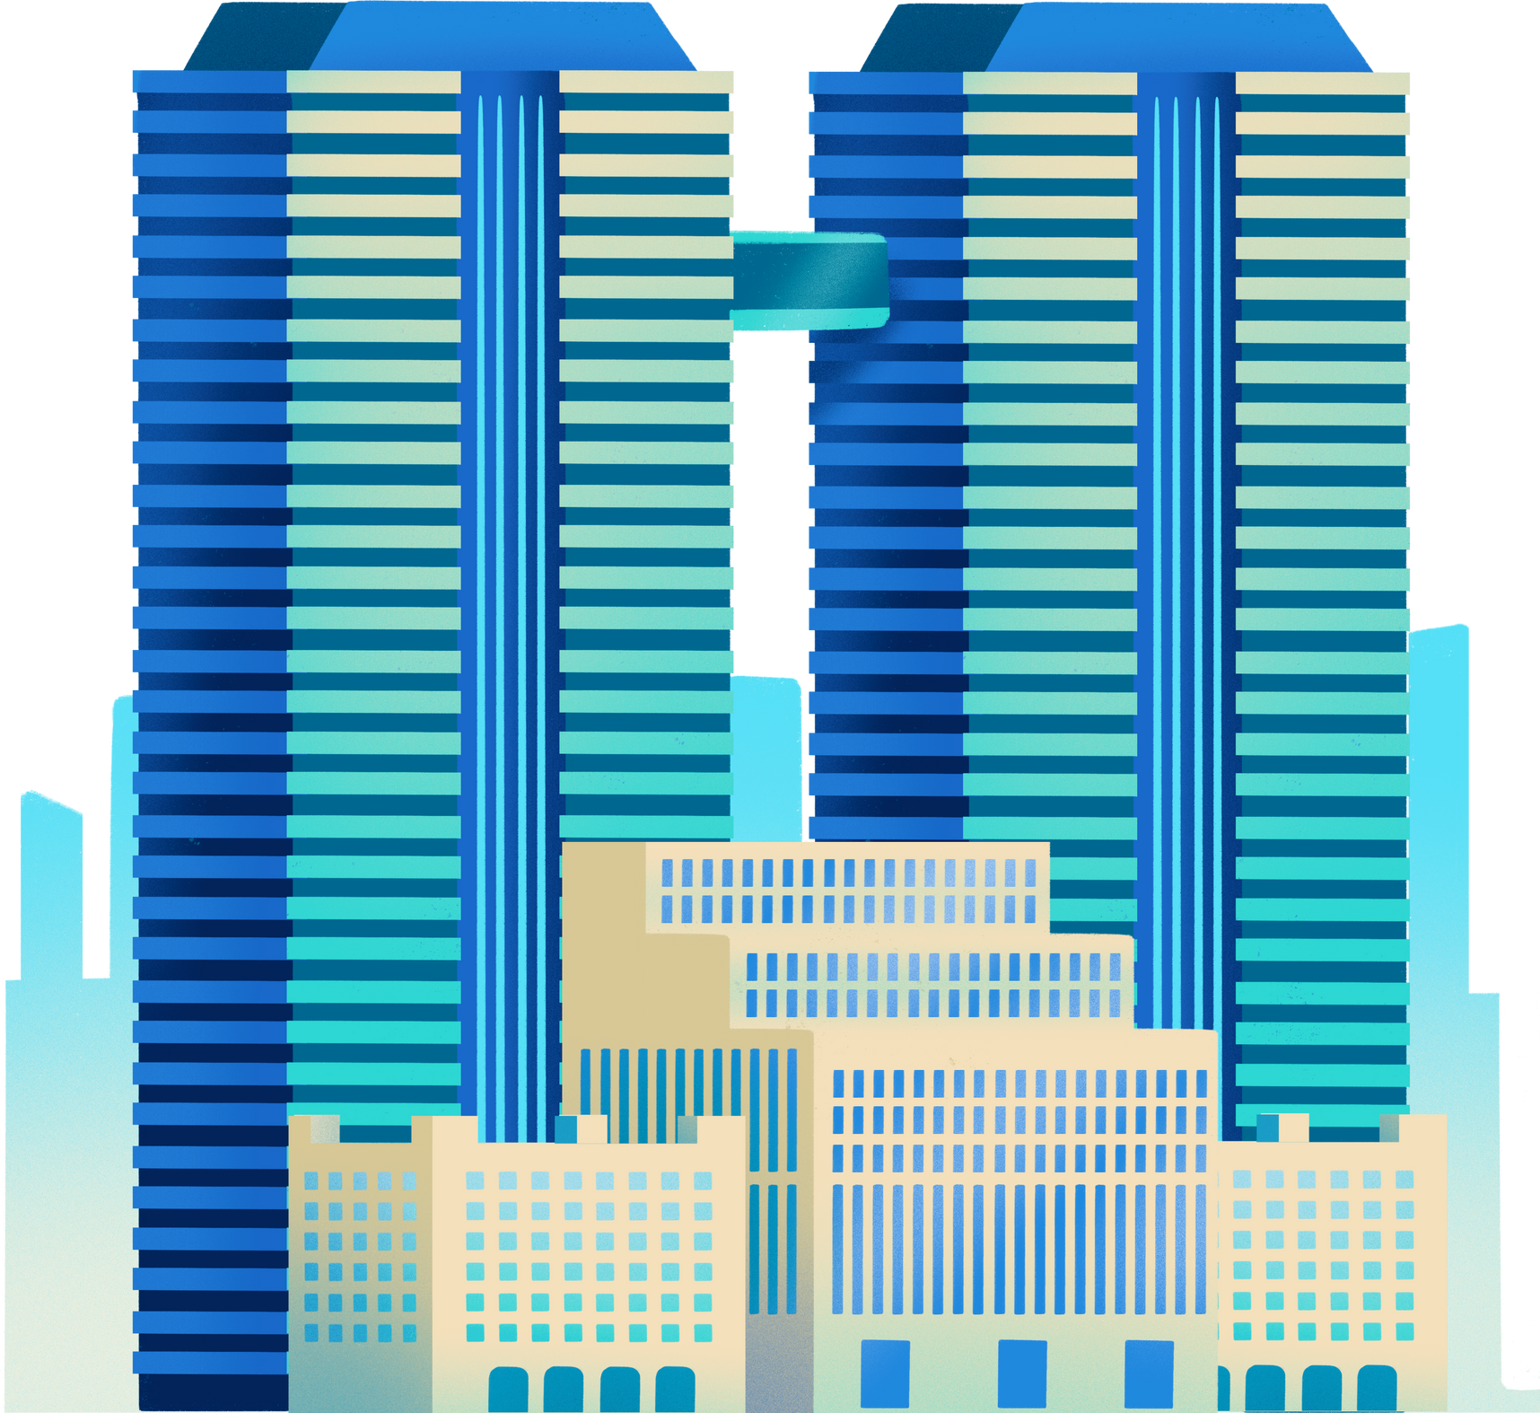


Tetra
City
BY TETRAPACK

Slide 2

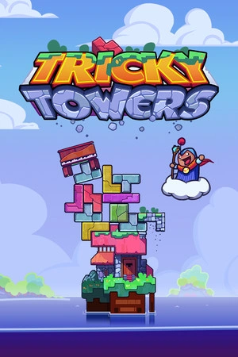
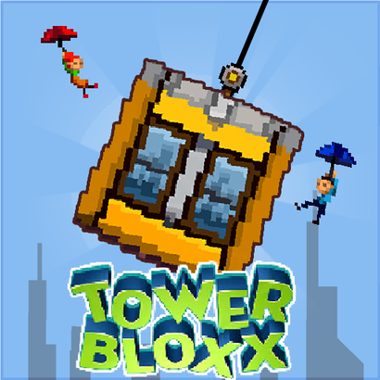
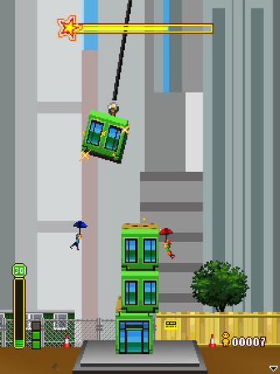
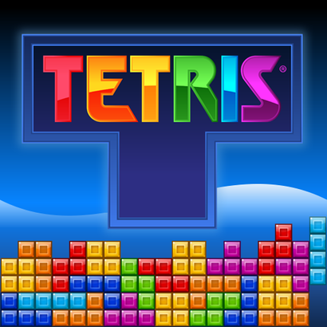

The inspiration behind
Notes:
Before smartphones became integral to daily life, entertainment options were simpler, especially during the era of basic cellular phones. The rise of mobile gaming in the 1990s introduced a new medium of entertainment to a broad audience. Iconic games like "Snake" on Nokia devices captivated millions and paved the way for mobile gaming. Inspired by this history, our Unity project fuses the nostalgic feel of classic games like "City Bloxx," "Tetris," and "Tricky Towers" into a modern gaming experience. This project aims to recapture the simplicity and addictive nature of these classics while introducing modernized gameplay elements grounded in today's technology. The game offers a combination of building mechanics, puzzle-solving, and real-time physics, providing players a fresh challenge that is both nostalgic and contemporary.

Slide 3

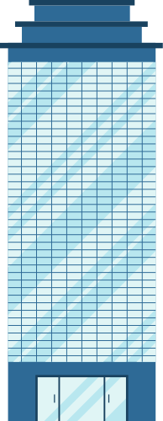


Game Type: Strategy and Puzzle
OVERVIEW
Theme: Urban construction and city building
Game Mode: Single Player
Notes:
Game Type: Strategy and Puzzle
Platform: Windows (Desktop)
Theme: Urban construction and city building
Game Mode: Single Player
Objective: Players aim to construct towering and stable structures by strategically placing Tetris-like blocks within a city-building simulation environment, timing their placement with precision

Slide 4

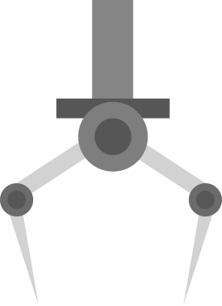

The player's view is similar to "Tetris," with blocks coming from above in a claw.
Players can reserve or swap blocks and must carefully stack them due to the real-time physics, which may cause structures to sway and fall.
Game Details
Notes:
Game Details
Gameplay Elements: Set in an urban atmosphere, tall buildings emphasize the theme of stacking. The player's view is similar to "Tetris," with blocks falling from above. Players can reserve or swap blocks and must carefully stack them due to the real-time physics, which may cause structures to sway and fall.

Slide 5


Slide 6





WIN CONDITION:
Construct tall and sturdy buildings at a certain height without causing collapses!

Slide 7
What’s the catch?
The blocks have different weights. Different weights = different physics interactions!
The taller the height, the faster the claw moves.

Slide 8


HOW TO PLAY
DROP BLOCK
SWAP
ROTATE
SPACEBAR
or
LEFT MOUSE BUTTON
Press Q
Press E or RIGHT MOUSE BUTTON

Slide 9
Technical specifications
Low-poly 3D graphics ensure compatibility with most PCs.
The single-player game is designed for Windows, with integrated sound effects and background music.
Real-time 3D rigid body physics simulate collisions. Assets, including 3D objects, backgrounds, and sound effects, were sourced from the Unity store.
The game features a 9:16 aspect ratio, similar to mobile games.

Slide 10
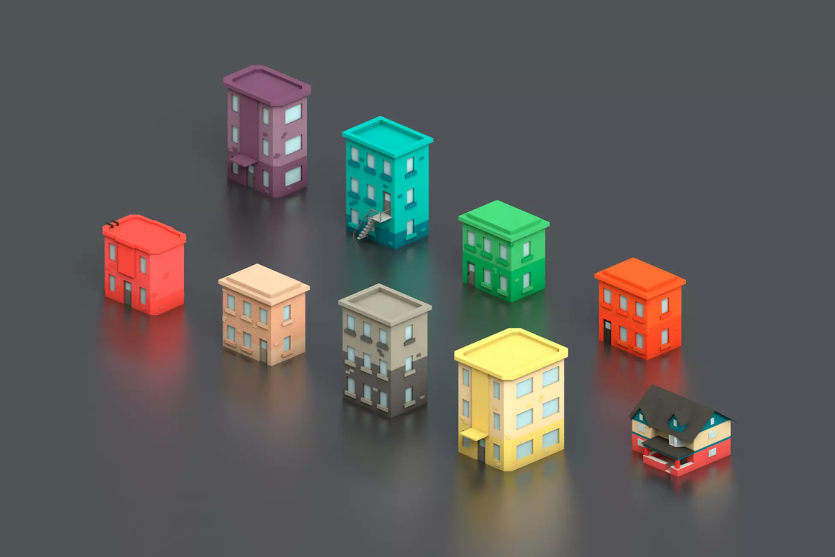
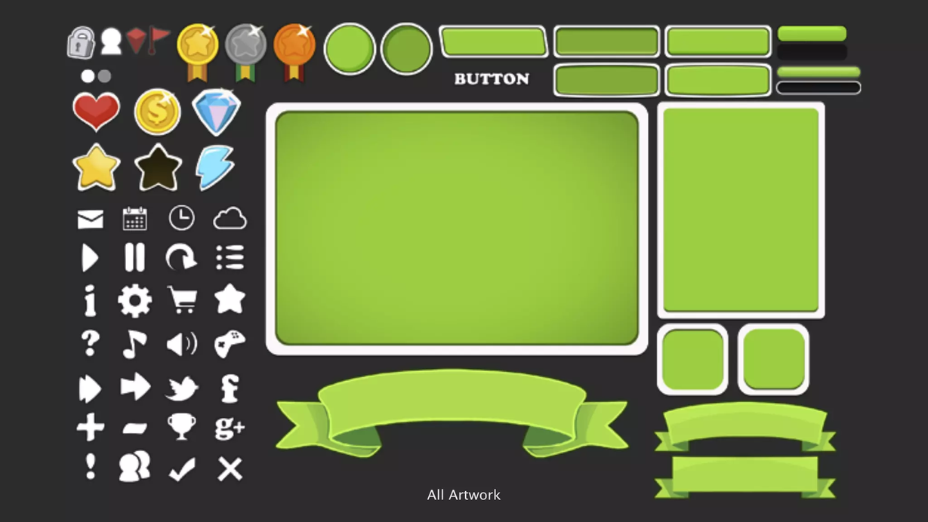
Assets
Free Low Poly Simple Urban City 3D Asset Pack by DraftPunk Studios
"2D Casual UI HD" package by MiMU Studio

Slide 11
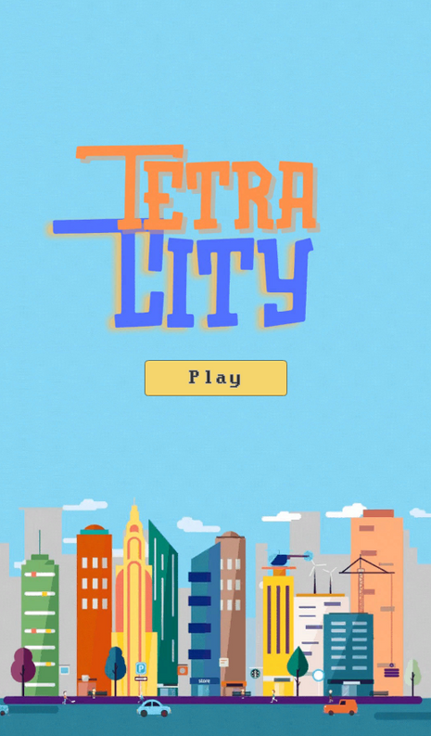
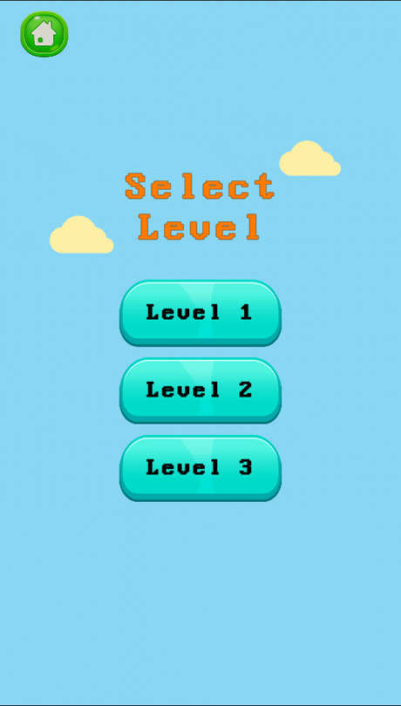
User Interface

Slide 12
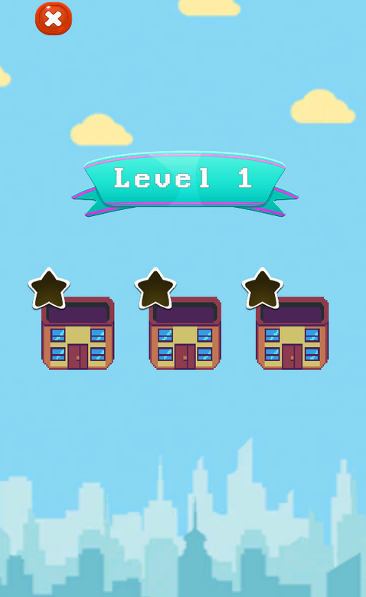
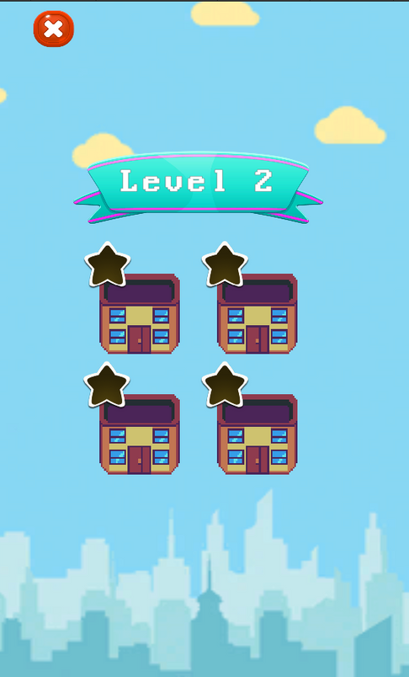
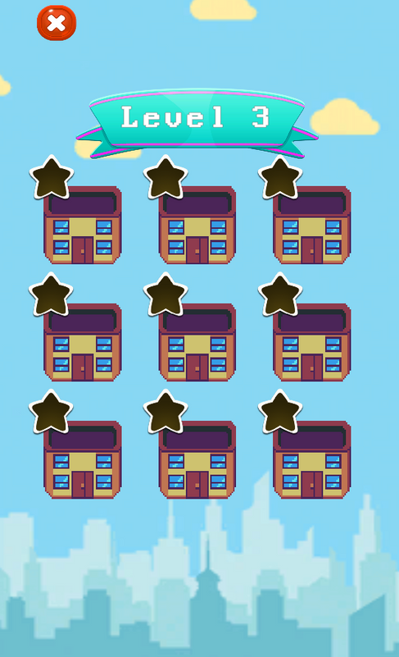
User Interface

Slide 13
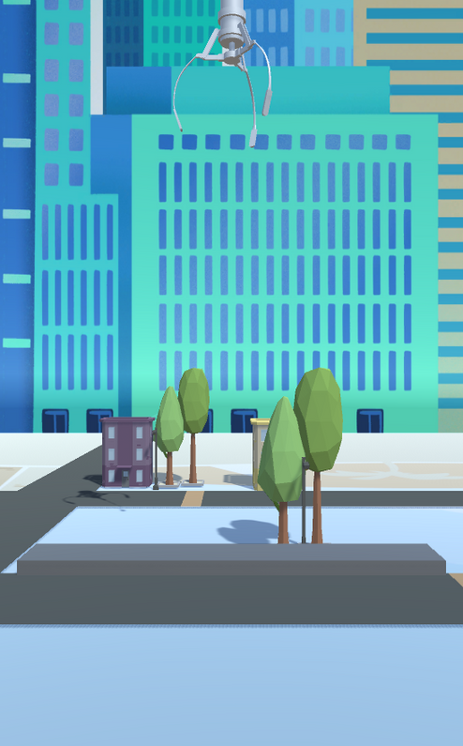
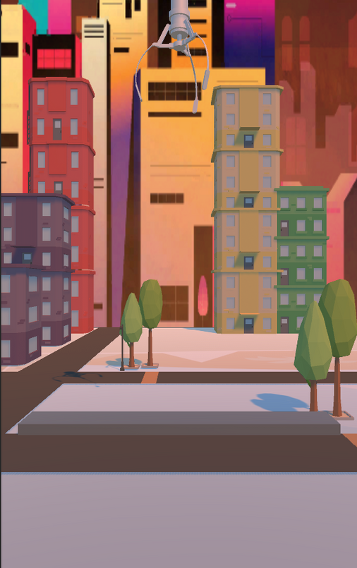
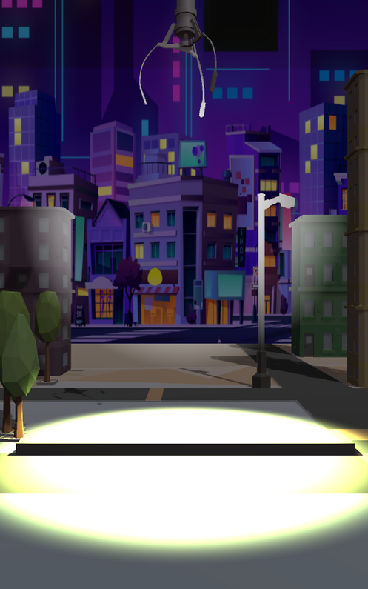
User Interface

